Slide 1
Our Discussion Goals
To define quantitative observations.
Define the measurements of length, mass, and volume.
To identify the basic types of measurements we will use in this class.

Slide 2
What is a quantitative observation?
Quantitative observations are observations that use numbers or measurements to describe amounts.
Usually made using tools.
Can you give some examples?

Slide 3
What are some examples of quantitative observations?

Slide 4
Length-the distance between 2 points
Mass-The amount of matter something contains
Weight-the force of gravity pulling down on mass
Volume-the amount of space something takes up.
Time

Slide 5
How do we take quantitative observations

Slide 6
We measure, which means we use tools to find an exact amount/quantity of a substance, object, event, etc.

Slide 7
What do we use to take quantitative observations?

Slide 8
Length-Meter sticks and rulers/tapes (metric)
Mass-Triple Beam Balance Scales or digital balance scales.
Volume-Liquid: Beakers and graduated cylinders.
Volume-Regular Solids: Math
Time-Stop watch.

Slide 9
What are some considerations when we measure?

Slide 10
Measuring is exact.
We must use precision. This means we are to repeatedly be close in our use of measuring skill. (Think of it as the what we do).
We also should be accurate when we measure. Accuracy is how correct or true your measure is. (Think of it as what we get).

Slide 11
What is precision?
The act of being exact as you measure.

Slide 12
What is accurate?
Accuracy is the results of your measurement being correct or actual.

Slide 13
How do we measure?
We use the right unit of measure.
We use the right tools to get exact amounts.
We set the tools at the right starting point. ….zero to start.
We get right with the tool…look eye level with our measure.
We get measure right …as precise as our tool allows.
We communicate measurements by placing a unit after the number.

Slide 14
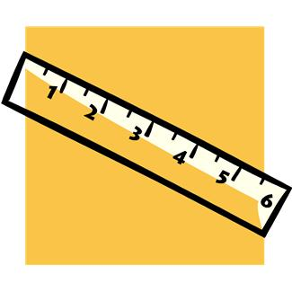
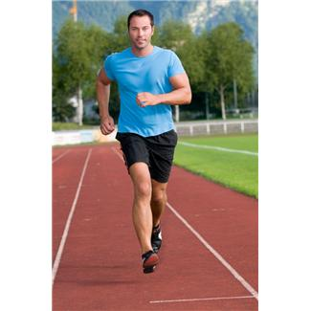
What is Length?
LENGTH is the distance between two points.

Slide 15
The tools used for length includes meter sticks, metric tapes, and metric rulers.
In metrics we use
meters (m) for basic measures
centimeters (cm) for small measures
millimeters (mm) for really small measures
kilometers (km) for really large measures.

Slide 16
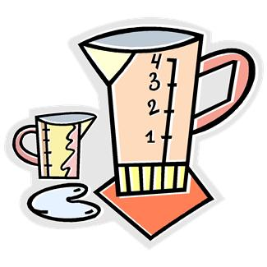
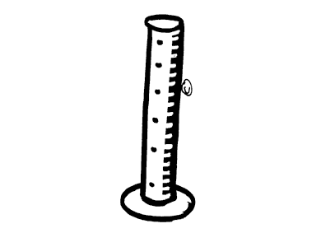
What is Volume?
Volume is the amount of space a substance takes up OR the amount of capacity to be filled.

Slide 17
The tools we use are the graduated cylinders (Tall and detailed) or beakers (big mouth with large measures).
In metrics we measure volume in
cm3 for solids and
ml for liquids.

Slide 18
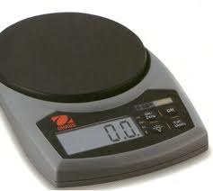
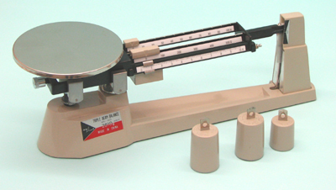
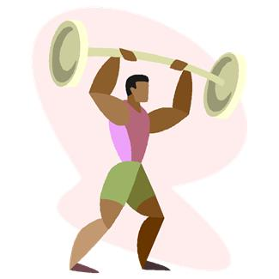
What is Mass

Slide 19
MASS is the amount of matter a substance is made of.
The tools we use to get mass are the triple beam balance scale or the electric balance scale.
We measure mass is
grams (smaller amounts) or
kilograms (larger amounts).

